Slide 1
Image Convolution with CUDA
Victor Podlozhnyuk
2017.03.23
Whiyoung Jung
Dept. of Electrical Engineering, KAIST

Slide 2
Contents
Introduction
Image Convolution
Convolution with Shared Memory
Optimizing for Memory Usage
Shared Memory Usage
Memory Coalescence
Performance Comparison

Slide 3
Introduction

Slide 4
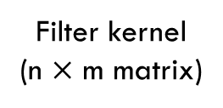

Image Convolution
3 | 1 | 2
3 | 1 | 1
2 | -1 | 1
1 | 2 | 4 | 5 | 5 | 2 | 3
5 | 3 | 1 | 2 | 2 | 3 | 5
7 | 3 | 1 | 1 | 3 | 4 | 3
4 | 2 | -1 | 1 | 2 | 1 | 1
5 | 2 | 1 | 3 | 5 | 5 | 2
4 | 2 | 1 | 2 | 1 | 5 | 1
 |  | -6
-3 | 0 | 2
-6 | 0 | 2
-2 | 0 | 1
Elementwise
-1 | 0 | 1
-2 | 0 | 2
-1 | 0 | 1
Sum all elements
n $×$ m multiplications / pixel
Filter kernel
(n $×$ m matrix)

Slide 5
Image Convolution
Separable Filter
-1 | 0 | 1
-2 | 0 | 2
-1 | 0 | 1
1
2
1
-1 | 0 | 1
Row filter
Filter kernel
Column filter

Slide 6
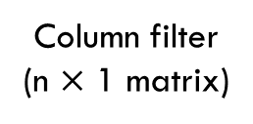
Image Convolution
1
1
-1
1 | 2 | 4 | 5 | 5 | 2 | 3
5 | 3 | 1 | 2 | 2 | 3 | 5
7 | 3 | 1 | 1 | 3 | 4 | 3
4 | 2 | -1 | 1 | 2 | 1 | 1
5 | 2 | 1 | 3 | 5 | 5 | 2
4 | 2 | 1 | 2 | 1 | 5 | 1
7 | 7 | 9 | 12 | 12 | 7 | 11
8 | 11 | 7 | 10 | 12 | 12 | 16
23 | 11 | 2 | 5 | 10 | 12 | 12
20 | 9 | 0 | 6 | 12 | 11 | 7
 |  | 2 | 9 | 13 | 16 | 6
13 | 6 | 3 | 7 | 7 | 15 | 4
1
2
-1
Elementwise
Sum all elements
1
2
1
n multiplications / pixel
Column filter
(n $×$ 1 matrix)

Slide 7
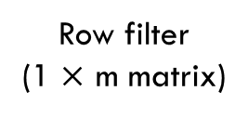

Image Convolution
7 | 7 | 9 | 12 | 12 | 7 | 11
8 | 11 | 7 | 10 | 12 | 12 | 16
23 | 11 | 2 | 5 | 10 | 12 | 12
20 | 9 | 0 | 6 | 12 | 11 | 7
18 | 8 | 2 | 9 | 13 | 16 | 6
13 | 6 | 3 | 7 | 7 | 15 | 4
11 | 2 | 5
 |  | -6
-11 | 0 | 5
Elementwise
Sum all elements
-1 | 0 | 1
Row filter
(1 $×$ m matrix)
m multiplications / pixel
(n $+$ m) multiplications / pixel in total

Slide 8
Convolution using Shared Memory
Apron pixels
Image pixels
Pixels calculated in a block
Convolution filter
Store into the shared memory
of the block
Image

Slide 9
Convolution using Shared Memory
Image pixels
Row Convolution filter
Pixels calculated in a block
Image pixels
Column Convolution filter
Image
Store into the shared memory
of the block

Slide 10
Focus of Contents
For separable filter, how to use shared memory
Compare the image convolution with and without shared memory

Slide 11
Optimizing for Memory Usage

Slide 12
Optimizing Memory Usage
Total Number of Loaded Pixels into Shared Memory
Aligned and Coalesced Global Memory Access

Slide 13
Shared Memory Usage
Maximize image pixels and minimize apron pixels
i.e. minimize #apron pixels / #image pixels
Better

Slide 14
Shared Memory Usage
More pixels to be loaded in each thread block
Then, each thread must process more than one pixel.

Slide 15
Memory Coalescence
Memory coalescing to global memory (row convolution)
We can make image block flexibly
But, size of apron block is fixed
Memory access by a warp may not be aligned
Kernel_Radius
Row_Tile_W
Kernel_Radius

Slide 16
Memory Coalescence
Memory coalescing to global memory (row convolution)
Put additional threads on the leading edge of the processing tile, in order to make threadIdx == 0 always reading aligned address so that all warps access global memory at aligned address
Kernel_Radius
Row_Tile_W
Kernel_Radius
Kernel_Radius_Aligned
blockDim.x

Slide 17
Memory Coalescence
Memory coalescing to global memory (column convolution)
Choose proper weight of the tile so that all warp access aligned global memory
No additional threads are needed to access aligned address
Kernel_Radius
Column_Tile_W
(blockDim.x)
Kernel_Radius

Slide 18
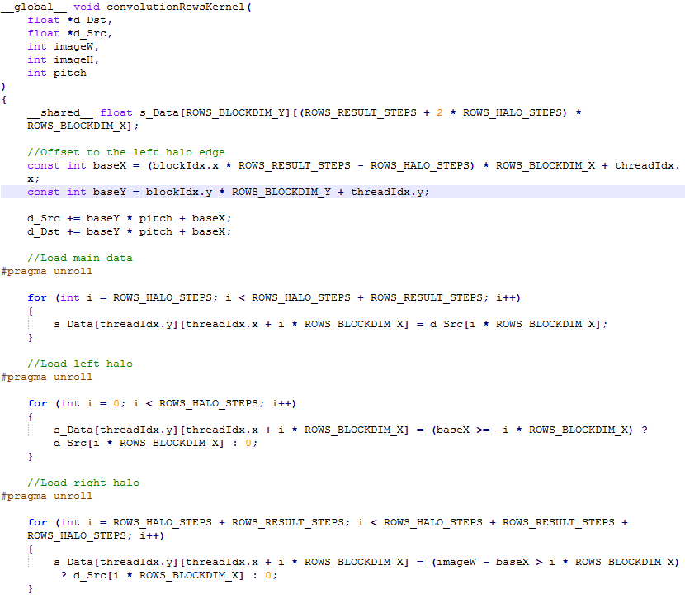
Row convolution
Algorithm
Load main data
Load apron data on left & right side

Slide 19
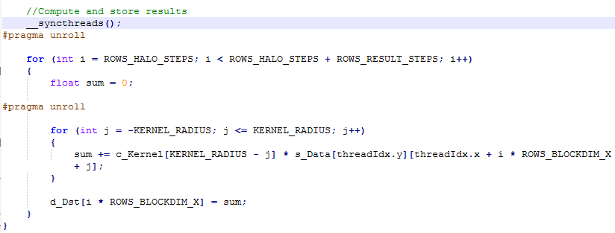
Row convolution
Algorithm
Do row convolution and save

Slide 20
Source code
Source code (in CUDA sample)
convolutionSeparable.cu
Convolution with shared memory
convolutionSeparable_kernel.cu
Convolution without shared memory
convolutionSeparable_gold.cpp
Convolution in CPU

Slide 21
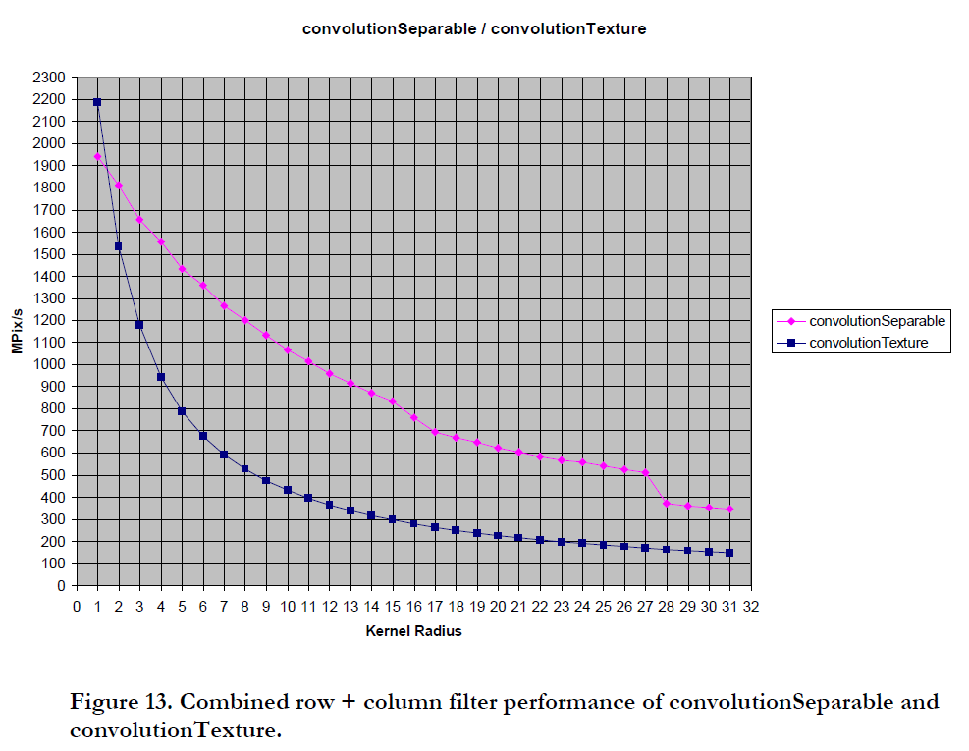
Performance Comparison
With shared memory
Without shared memory

Slide 22
Conclusion
Use of shared memory improves the performance
Memory coalescing technique can result in better performance

Slide 23
Thank you

